Slide 1



Mobile Device Forensics: Unlocking Smartphones for Evidence
Explore mobile forensics and its vital role in law enforcement. Learn techniques for unlocking phones and extracting data. Understand legal and ethical safeguards ensuring evidence is admissible and integrity maintained.

Slide 2
Team Members
2210030170-Manish Reddy
2210030171-Bussa Kedaar
2210030241-CH. Sravan Suraj
2210030290-G. Aneesh
2210030488-Sai Venkat Reddy

Slide 3
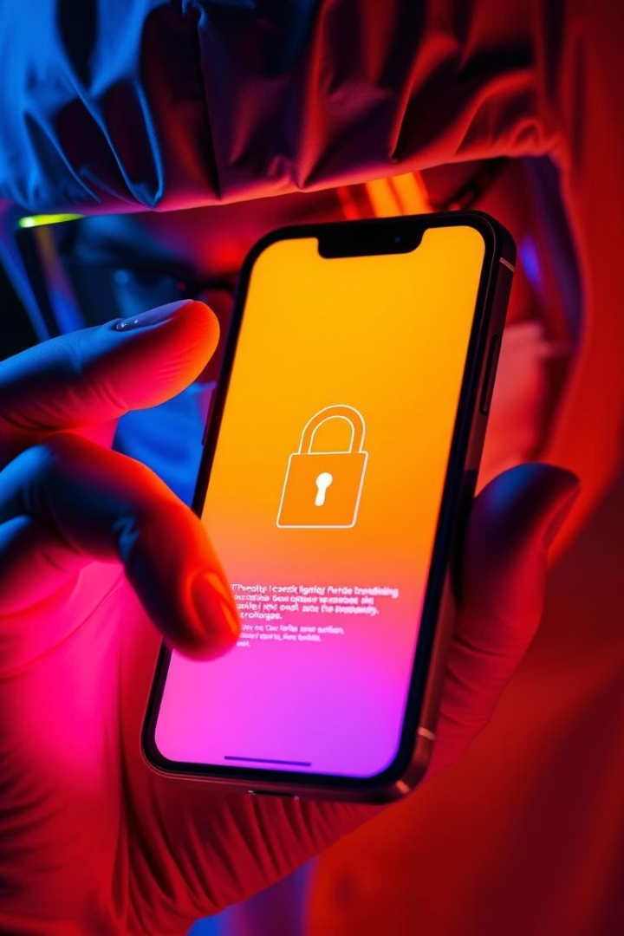
Forensic Process Workflow: A Step-by-Step Methodology
Device Seizure
Secure the device carefully, documenting condition and details.
Isolation
Place in Faraday bags to block network signals and remote access.
Imaging
Create a forensic duplicate to preserve original data integrity.

Slide 4
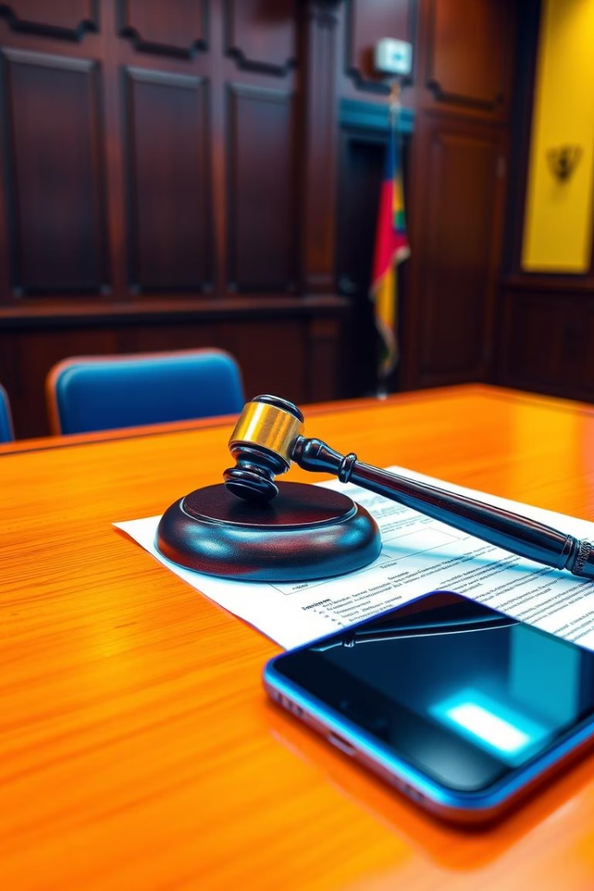
Legal Considerations in Mobile Forensics
Search Warrants
Chain of Custody
Obtaining legal authority is critical before data extraction.
Detailed records ensure evidence is traceable and untampered.
Evidence Admissibility
Data must be collected and preserved to stand up in court.

Slide 5

Unlocking Techniques: Bypassing Security Measures
Password Cracking
OS Vulnerabilities
Techniques include dictionary attacks and brute forcing PIN codes.
Leveraging software flaws to bypass security features.
Hardware Methods
Using physical tools to access phones with locked or damaged systems.

Slide 6
Data Extraction: Retrieving Digital Evidence
Logical Extraction
Physical Extraction
Forensic Tools
Captures data accessible via standard interfaces and apps.
Retrieves complete raw data including deleted files and partitions.
Specialized software and hardware enhance data recovery and analysis.

Slide 7




Data Analysis: Uncovering Insights from Mobile Devices
Call Logs & SMS
Trace communication patterns crucial for investigations.
Media Files
Analyze photos, videos, and audio for evidence clues.
Location Data
Track user movements through GPS and network data.

Slide 8

Forensic Reporting: Documenting Findings
1
Report Structure
2
Clear Presentation
Organize with clear sections: methods, findings, conclusions.
Use simple language to explain technical evidence convincingly.
3
Accuracy & Objectivity
Ensure facts are precise and free from personal bias.

Slide 9



Case Studies: Real-World Applications of Mobile Forensics
Corporate Espionage
2
Identify data breaches and unauthorized information leaks.
Criminal Investigations
Recover vital evidence in homicide and assault cases.
1
Civil Litigation
3
Prove intellectual property theft and contract disputes.

Slide 10




Challenges and Future Trends in Mobile Forensics
Encryption
1
Strong encryption complicates data access and analysis.
2
Anti-Forensics
Techniques to obscure or destroy digital traces challenge investigators.
3
The Cloud
Data spread across cloud services adds complexity.
4
AI Analysis
Emerging AI tools enhance pattern recognition and threat detection.

Slide 11

Conclusion: The Future of Mobile Forensics
Essential Role
Technological Evolution
Ethical Commitment
Mobile forensics is crucial for modern digital investigations.
Adapting methods to keep pace with advancing technology remains vital.
Maintaining integrity and privacy protects legal standards.

